Slide 1

City Hotel Booking Analysis
Presented By: Manisha Gupta

Slide 2

Point for Discussion
Summary of data
Data wrangling
Data analysis
Data visualization
Conclusion

Slide 3
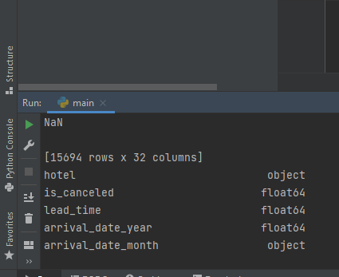
Summary of Data
The dataset has a shape of 15694 which mean that it contains 15,694 rows and 32 columns
This data set contains booking information for a city hotel and includes information such as when the booking was made, length of stay, lead time, children, and/or babies, and an arrival date year, among other things. All personally identifying information has from the data.

Slide 4
Data wrangling
Data Cleaning-
This data file consist of null values ‘Nan’.
Replaced those null values with zero.
Data Preparation-
Data file consist of different types of data types.
Data type: integer, float, object.
Converted the ‘float’ data type into ‘integer’ data type.

Slide 5
Data Analysis
How Many Bookings Were Cancelled?
Which is the busiest month of hotels?
From which country most guests come?
How Long People Stay in the hotel?
Which market segment makes the highest number of bookings?
What is the most preferred meal by customers?
Which type of customer usually come to the hotel?
Which room type is in most demand?

Slide 6
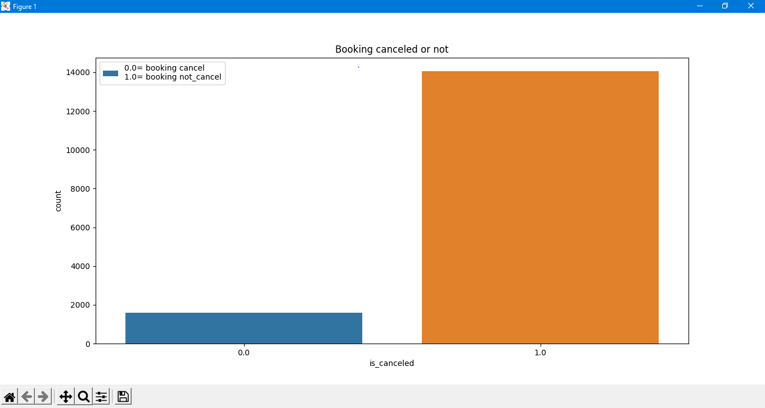
Data Visualization
Booking Cancelation
Rate
Here 0 indicates booking is canceled and 1 indicates booking is not canceled.
Hence, we can see that most of the time booking were not canceled.

Slide 7
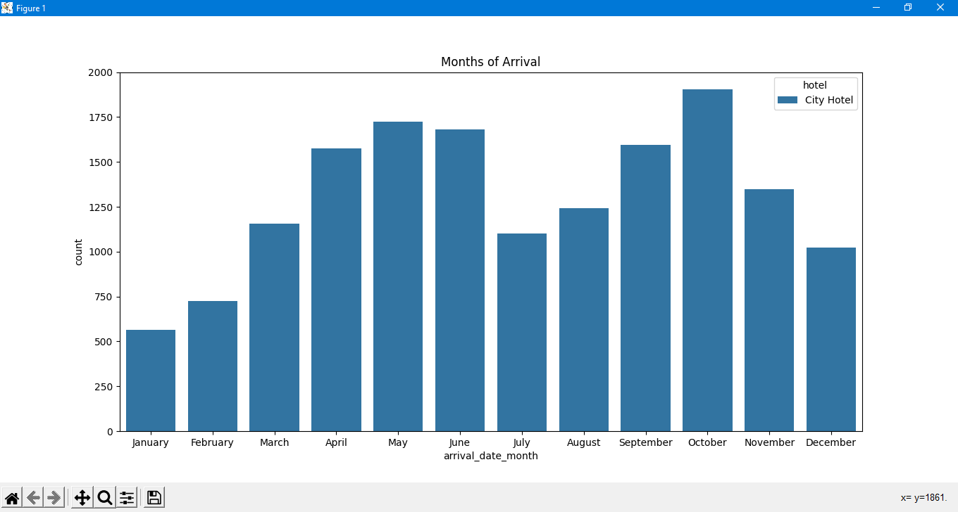
Most of the booking were made from month of April to June and peak in month of October. least booking was made at the start and end of the year.
Busiest Month Of Hotel

Slide 8
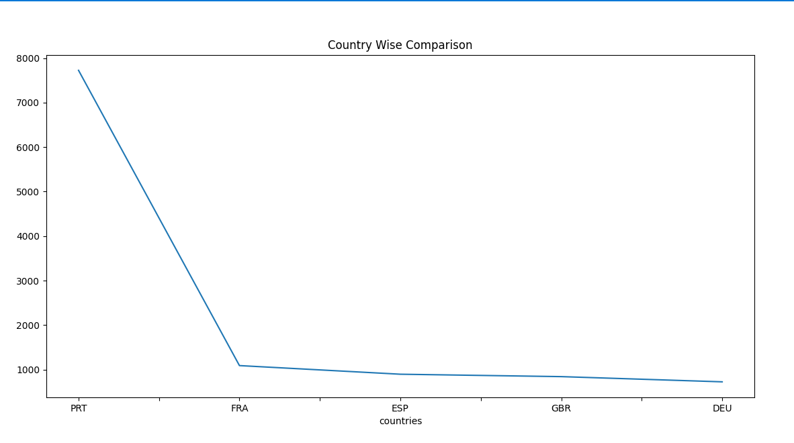
Arrival of guests is high and above from the countries with code: DEU, ESP, FRA, GBR and PRT Portugal, France, and Spain and Great Britain Germany are the top countries, most guests come from these 5 countries.
Country Wise Comparison

Slide 9
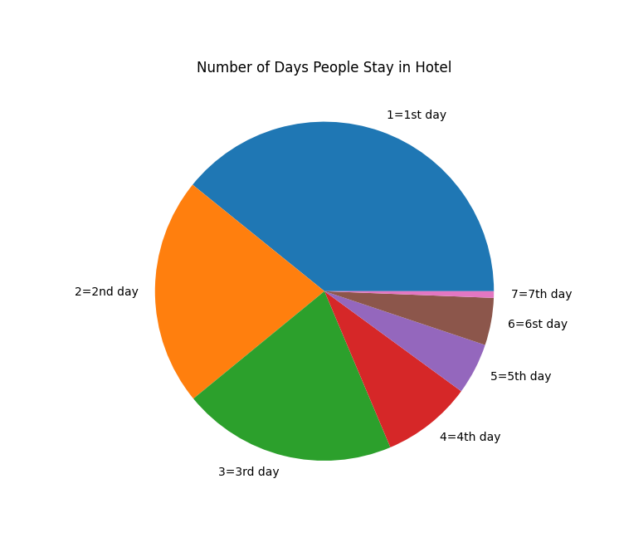
Most Common Stay
Duration
In City hotel, most popular stay duration is one, two, or three days.
Most people stay for one, two, or three. More than 60% of guests come under these three options.

Slide 10
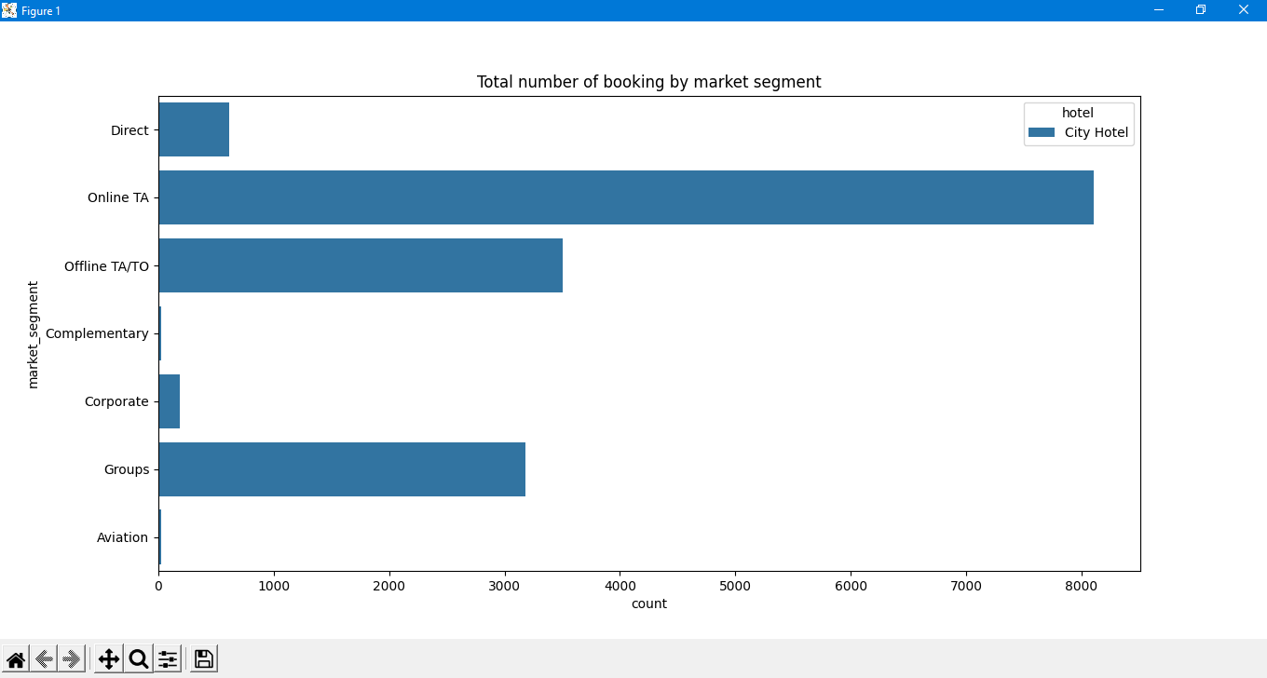
Greatest number of bookings done via Online through Travel Agent.
Most Common Booking by Market Segment

Slide 11
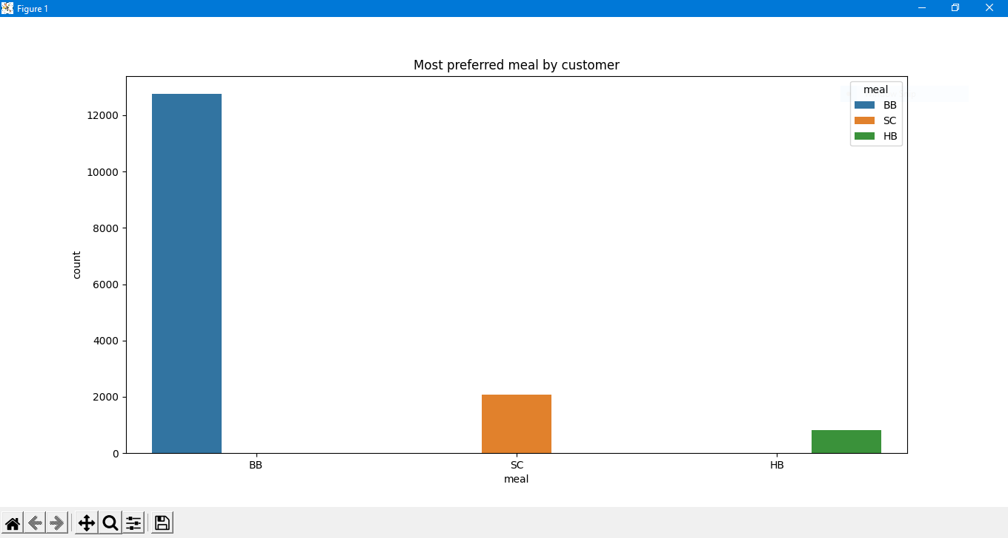
Most Preferred Meal by Customer
Most people were booked
BB meal (Bed & Breakfast)
and least people were
booked HB meal (Half
Board). Hotel can make a
meal plan according to
report.

Slide 12
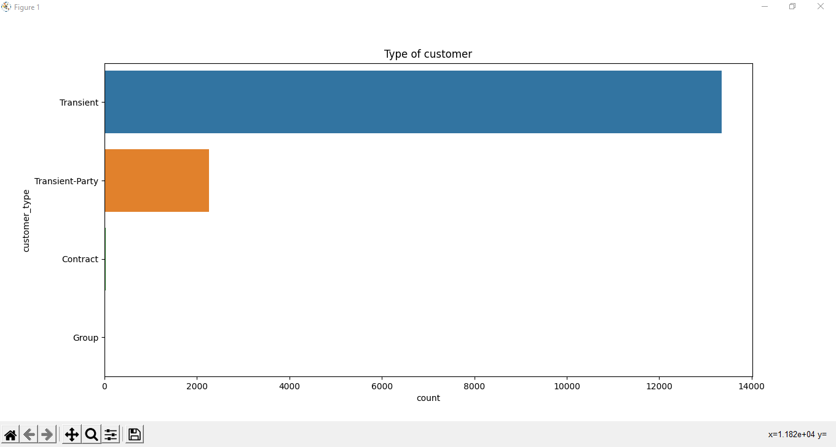
Most of the customers/guests were Transient type. More than 96% of customers were transient and least type of customers were in groups.
Type of Customer Usually Come to the Hotel

Slide 13
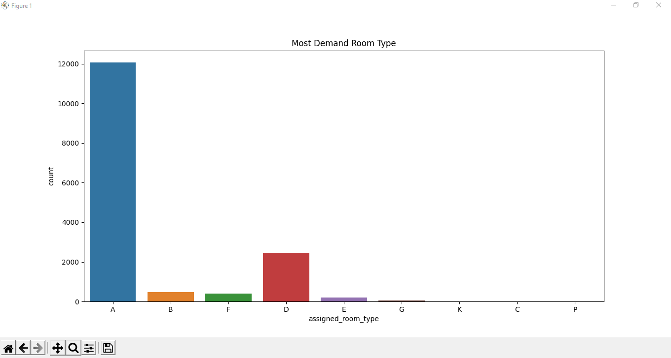
Most demanding room type
let see A, B, D, E, F, G room type means.
A= One Room (one person or couple) B= Double Room
D= Triple Room E= Quad Room
F= Queen Size G= King size
Most demand room type by customer is type A that is one room for one person or couple.

Slide 14
Conclusion
City Hotel cancellation rate were low. Most of the time booking were not canceled.
In City Hotel most booking was made from April to June and peak in month of October and least booking were made at start and end of the year.
Portugal were the country which had maximum number of hotel bookings.
In city hotel most popular stay duration is one, two and three days. More than 60% of guest come under these three options.
Guest uses different channel for making booking, out of which most preferred way were online through Travel Agent.
Most people preferred BB meal (Bed & Breakfast).
In city hotel most of the guest were Transient type. It can be seen that more than 96% of the guest are Transient.
Room type A were most demand room.

